Slide 1


Information and communication technologies: Final report Database project
Furniture Online-Store Management System
Group members: Aya Almatay, Olzhas Uikas, Dias Doktyrbek
Group name: BD-2006
Instructor: M.Ed. Aivar Sakhipov
Nur-Sultan, 2020

Slide 2


MAIN PURPOSE
Project is aimed at developing a web application that depicts online shopping of furniture.
This application helps customer to find different type of furniture and creates an opportunity for delivering directly to the address of the customer.

Slide 3
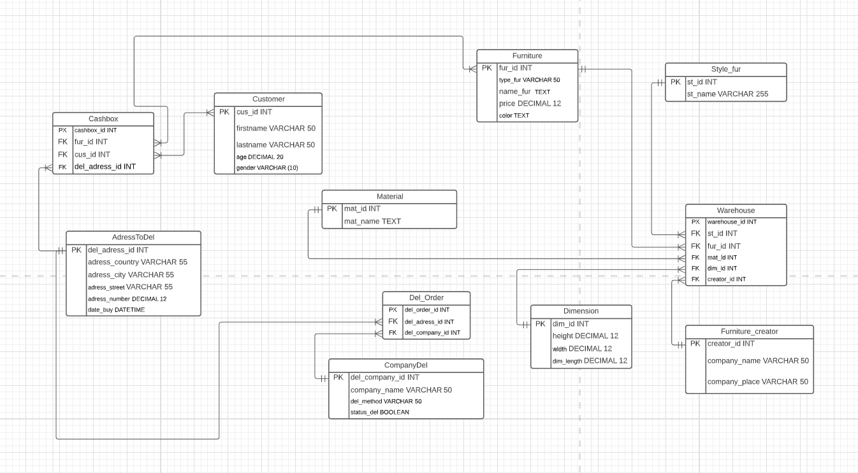
Entity Relationship Diagram (ERD)
4
STUDENTS

Slide 4

Responsibilities
Olzhas Uikas:
Create ERD,
Create database,
Business rules.
Dias Doktyrbek:
Presentation,
ALTER TABLE statements.
Aya Almatay:
Business rules,
DML statements.
4
STUDENTS

Slide 5
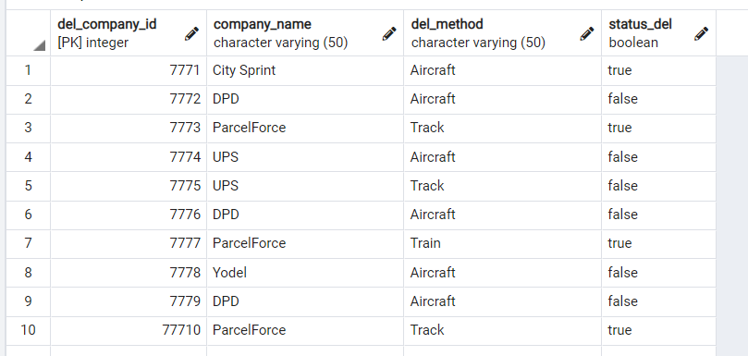
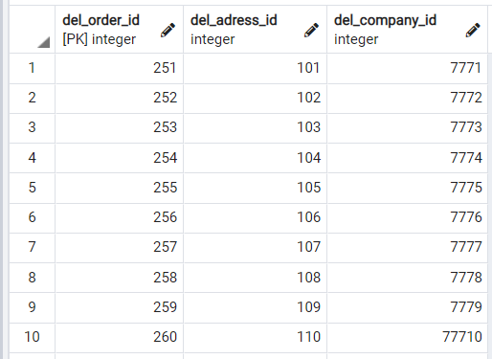
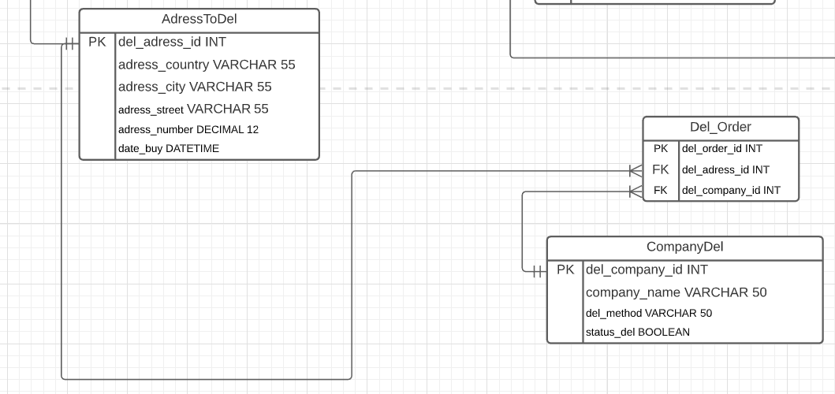
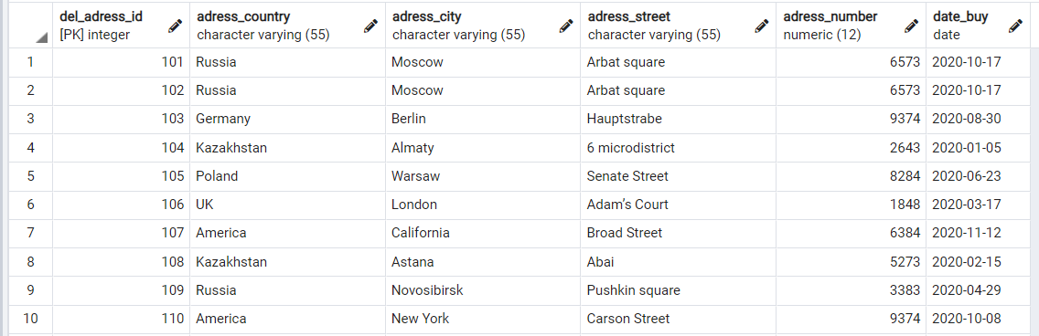
Tables: Part 1
CompanyDel
Del_Order
4
AddressToDel
STUDENTS

Slide 6
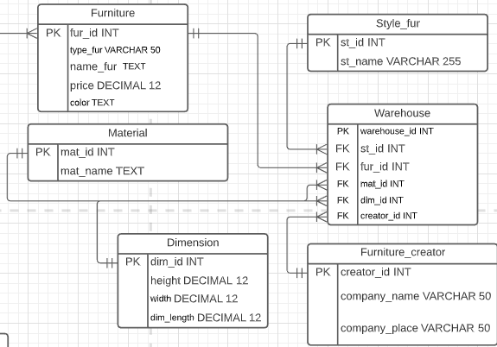
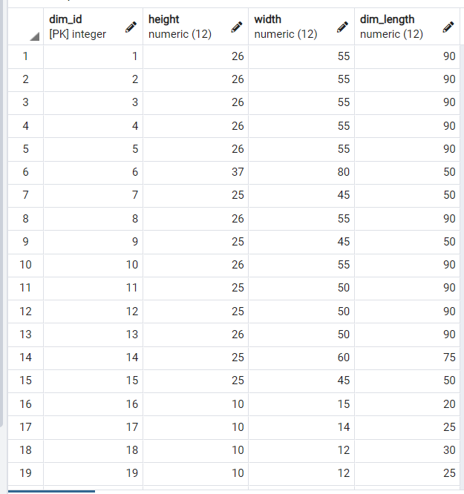
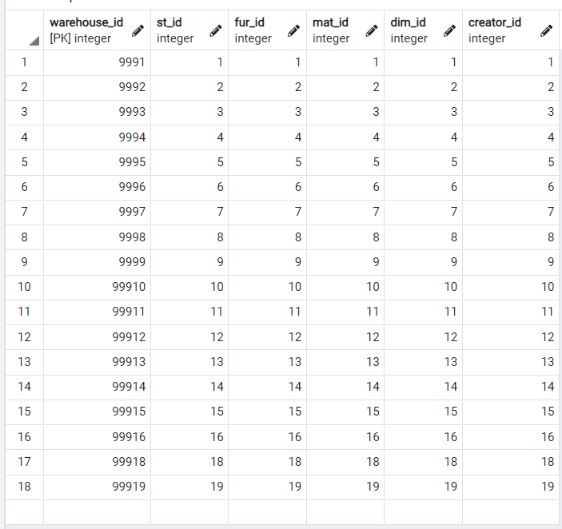
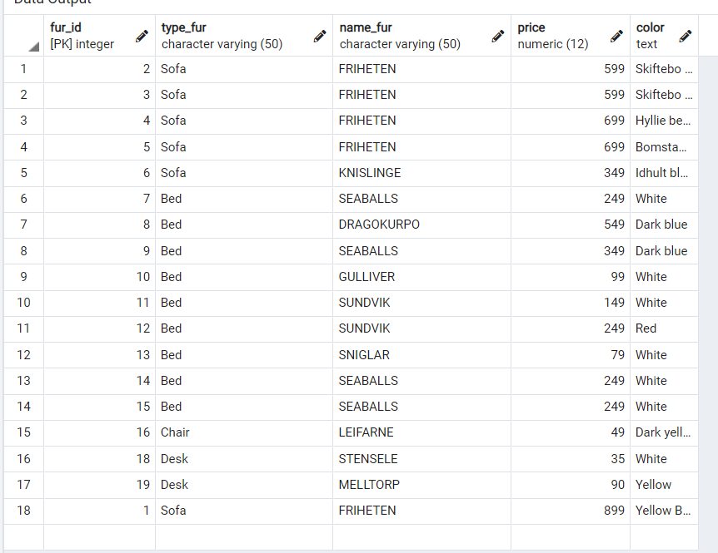
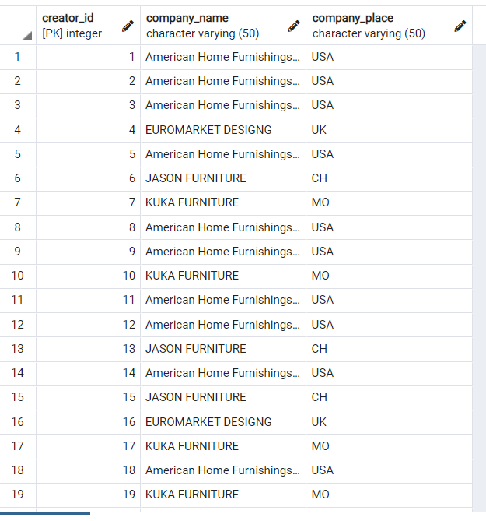
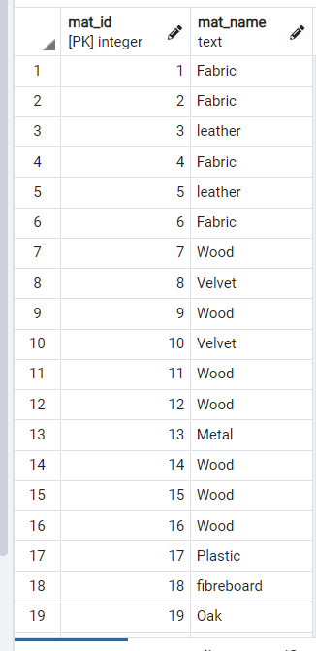
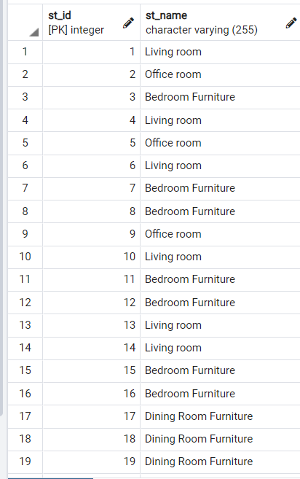
Tables: Part 2
Dimension
Warehouse
4
STUDENTS
Furniture
Furniture_creator
Material
Style_fur

Slide 7
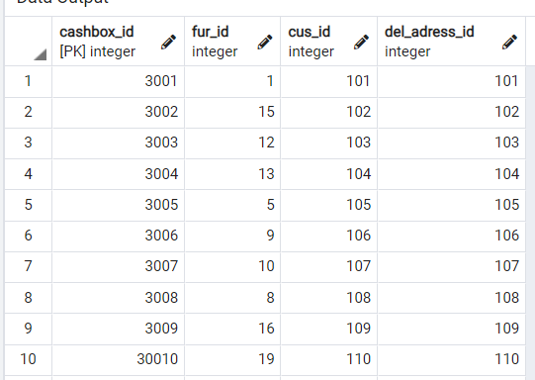
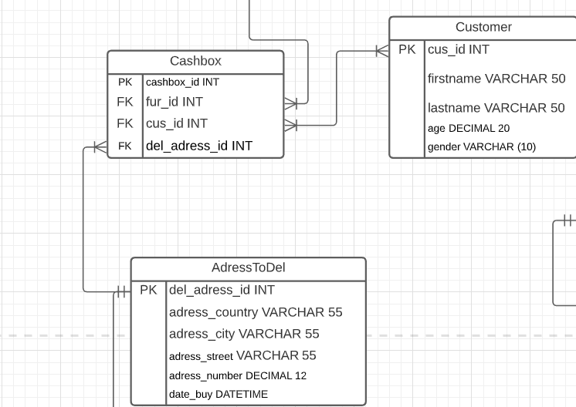
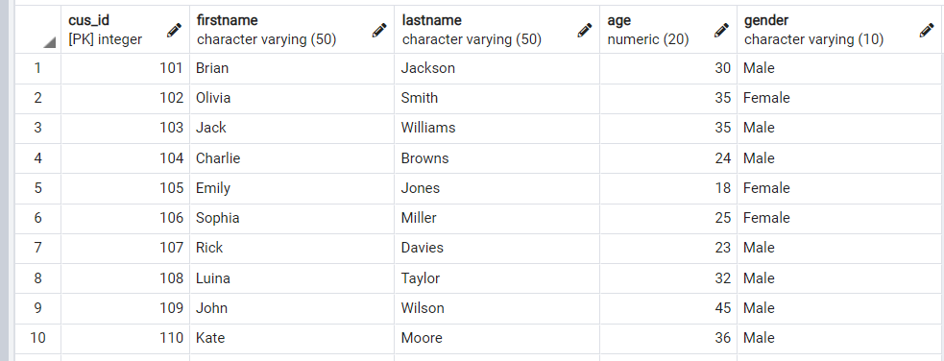
Tables: Part 3
Cashbox
4
STUDENTS
Customer

Slide 8

Business rules
1. One Furniture has a one Furniture Creator
2. One Furniture Creator can create one or many Furniture
3. Many Customers can buy and order many Furniture
4. One Furniture has only one Furniture Type 5. Many Orders may have one Address
6. Same Materials have one or many Furniture
7. One Furniture has one Material
8. On Furniture can be only on Furniture Style
9. One Delivery Company have one or many Order
10. One Furniture can be order only one Customer
4
STUDENTS

Slide 9

Challenges while developing a project
1. Creating a concept for the project.
2. Relationship problems.
3. During the design of the ERD, many columns were added and removed.
4. Multiple Row and Multiple Column Subqueries were difficult to do query.
4
STUDENTS

Slide 10

Learning outcomes from the work done
1. Got experience in creating database.
2. Improved the ability to write code in SQL shell (psql).
3. Our knowledge helped a lot when working on the project.
4. We dealt with topics that we didn't understand and eventually understood .
4
STUDENTS

Slide 11

Summary: list of weaknesses and limitations of current implementation
1. Further additions besides furniture will lead to difficulties.
2. Switching to offline sales may result in the termination of the delivery of the company because of to pickup.
3. Dimensions may vary due to furniture differences. Here the overall dimensions were indicated without dividing into types of furniture. So it can be a problem when adding furniture.
4. Furniture may have more than one material, but several.
5. Database still needs improvement.
4
STUDENTS

Slide 12

Summary: list of potential future upgrades
Add an image to each product.
2. More detailed information about the product size.
3. Add a chat bot for support into the website or into mobile application.
4. Temporary discounts.
5. Add the possibility of shopping cart and etc.
6. Cashback.
7. Add email customer’s address to do a target marketing using cookies.
4
STUDENTS

Slide 13
Thank You!!!
4
STUDENTS

